Slide 1

Futurense
Democratizing Tech Talent to deliver impact at scale

Slide 2
Analysis of Demography and
Healthcare using Census(2011) Data
Chiranjeevi B,
FT625,
FF17.

Slide 3
Problem Statement
The main aim of the project is to collect, clean, process and analyze the different datasets related to 2011 cencus and get some meaningful insights concerning to the demographic and healthcare perspective
Step by step cleaning/modification of the data needs to be done

Slide 4
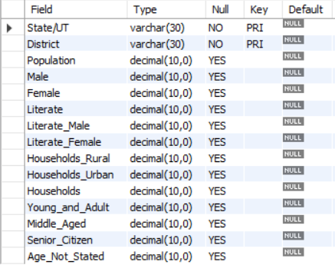
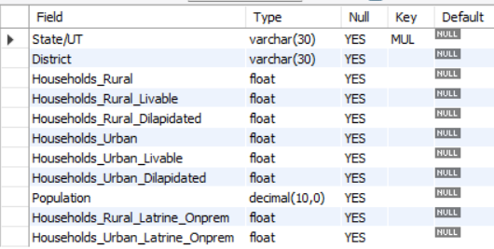
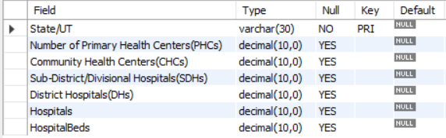
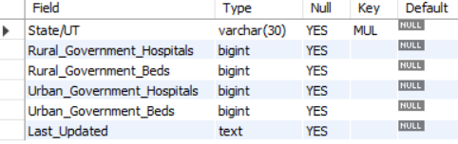
Schema of datasets
Housing data
Census data
Hospital data
Government_Hospitals data

Slide 5
Overview:
Data Cleaning
Data Preprocessing
Data Analysis
Connecting to MYSQL Database for further analysis

Slide 6




Tools and Technologies Used:
Python
Jupyter

Slide 7
Libraries/Packages/Features Used:
Pandas
Seaborn
Matplotlib
MySQL – Stored Procedures

Slide 8
Headline Statistics :
Average Execution Time : around 5 seconds
Lines of Codes (LoC/KLoC) : around 2K lines
IDE/Code Editor Used : Jupyter

Slide 9
Data Cleaning
There are few major datasets that have some inconsistencies. To proceed with further analysis, those inconsistencies needed to be found out and resolved .
Removing the columns which aren’t necessary to the analysis
Renaming the column names so that they are uniform across all datasets which will ease the process of analysis

Slide 10
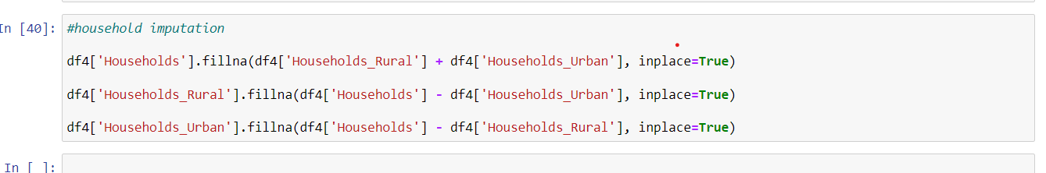
Data Preprocessing
There are few major datasets that have some inconsistencies. To proceed with further analysis, those inconsistencies needed to be found out and resolved .
Transformed some values in the tables so that they are uniform and the discrepancy among themselves is sorted.
Imputation of null values based on the values already present in the table .

Slide 11
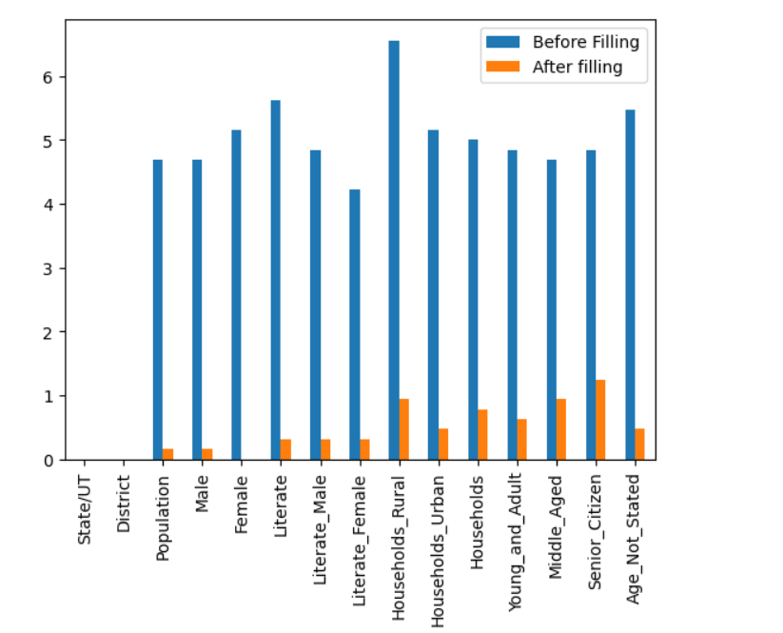
Visualization of Data before and after filling of missing/null values

Slide 12
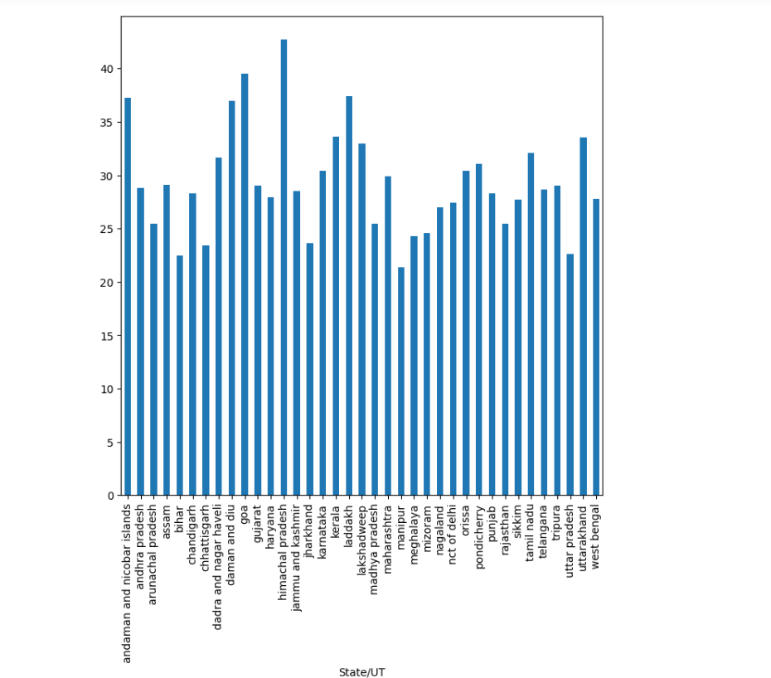
Number of households for 100 people in every State/UT.
Himachal Pradesh has the highest number of households for 100 people and Manipur has the lowest .

Slide 13
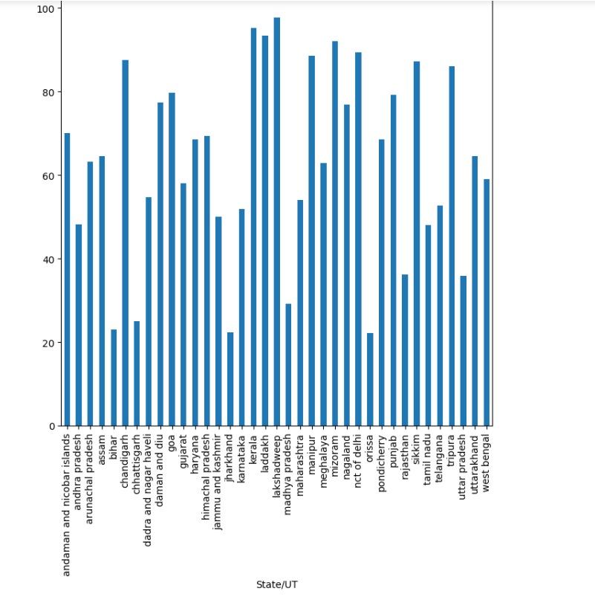
Percentage of households that have toilet on premise to the total number of households.
Based on the plot, Kerala has the highest no. of houses with toilets on premise and Orissa, Bihar and Jharkhand have the lowest .

Slide 14
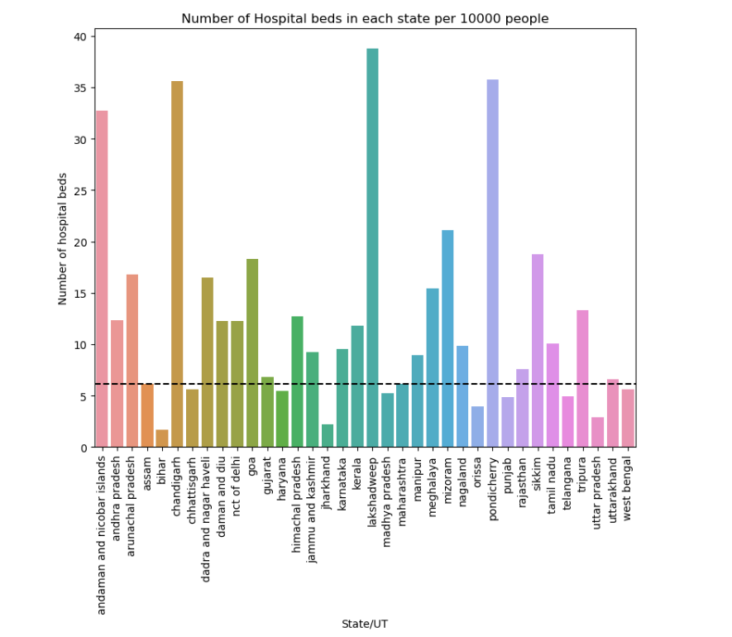
Based on the plot, Lakshadweep has the highest no. of beds per 10000 people, whereas the states Bihar, Jharkhand, and Uttar Pradesh have the lowest number of beds for 10000 people.

Slide 15
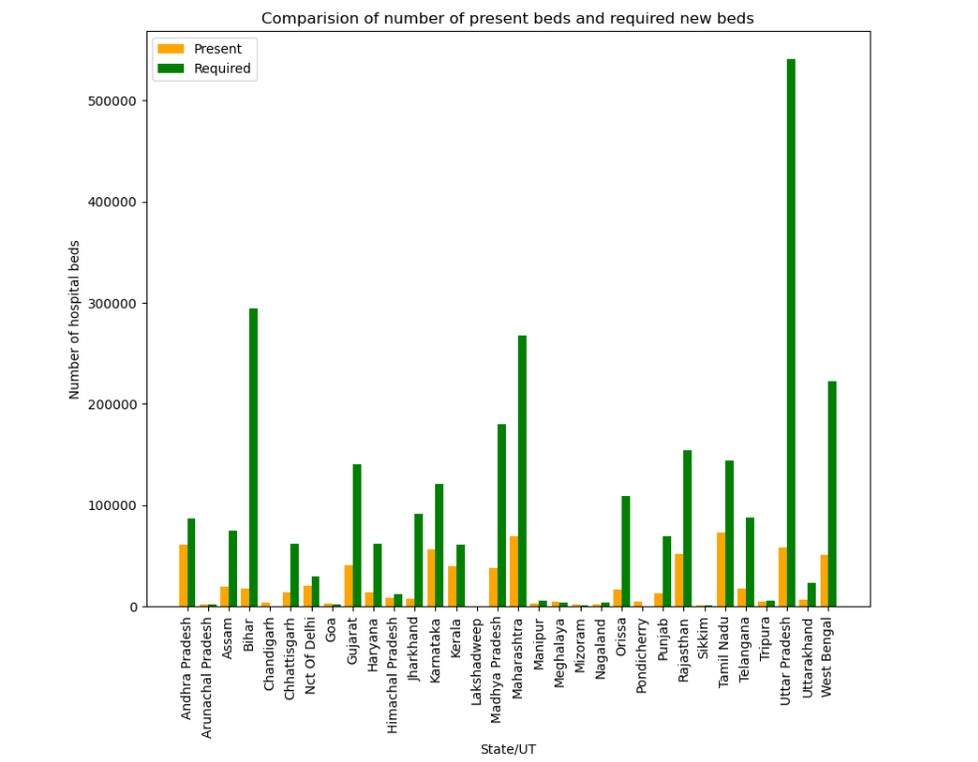
Based on the plot, Uttar Pradesh and Bihar are the states who require more no. of hospital beds compared to other states and also places such as Pondicherry and Chandigarh have more beds than the required amount.

Slide 16
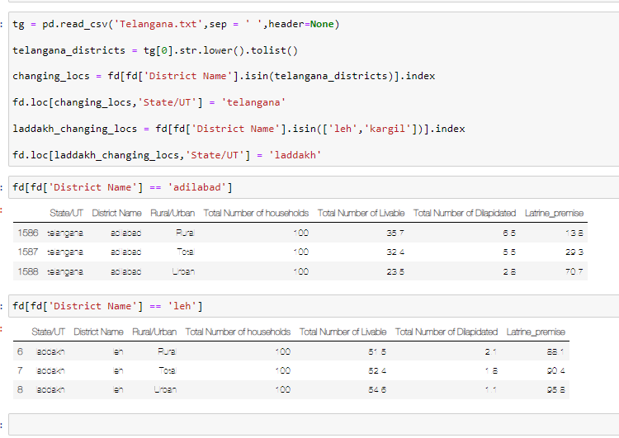
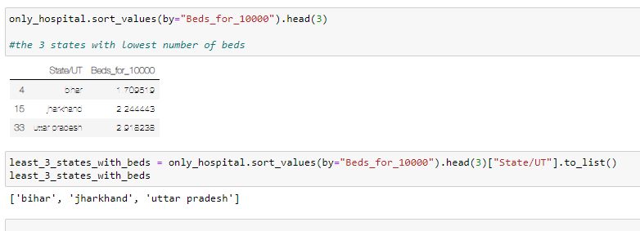
Code Snippets
Code to change the state/UT name to Telangana and Laddakh for districts whose states were still Andhra Pradesh and Jammu & Kashmir even after formation of new States and UT’s.
States with least no. of beds per 10000 people

Slide 17
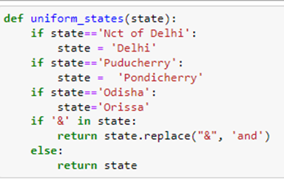
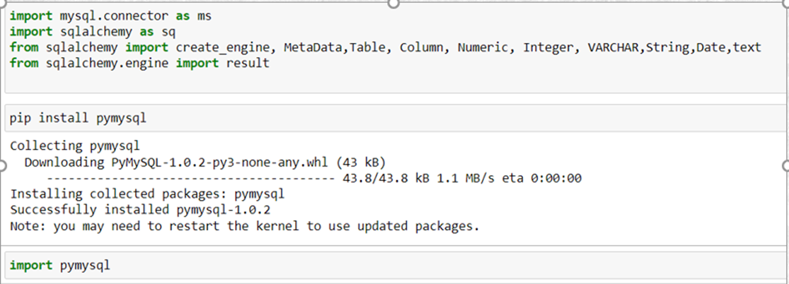
Code Snippets
Function to create uniformity in state names across all data sets.
Installing required packages and importing libraries for the Mysql Connection

Slide 18
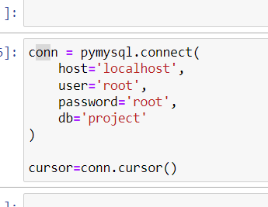
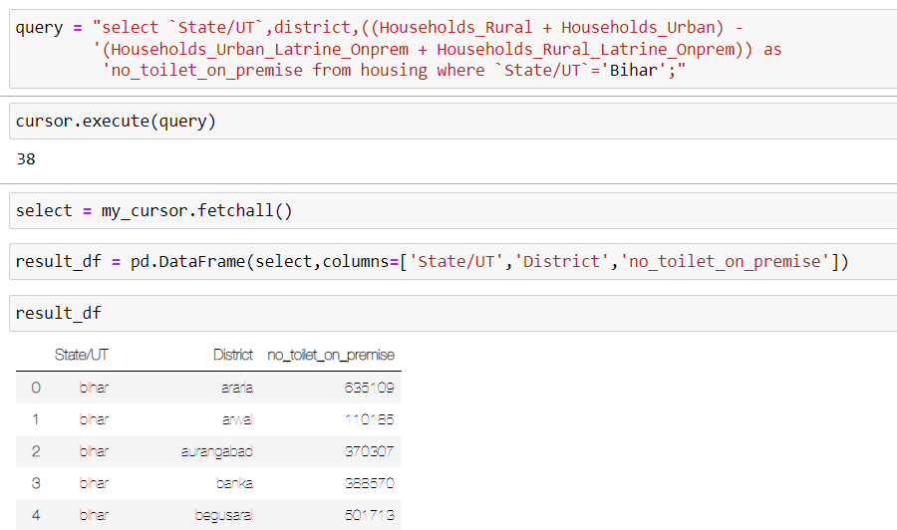
Code Snippets
Database Connection
Execution of a query using mysql connection

Slide 19
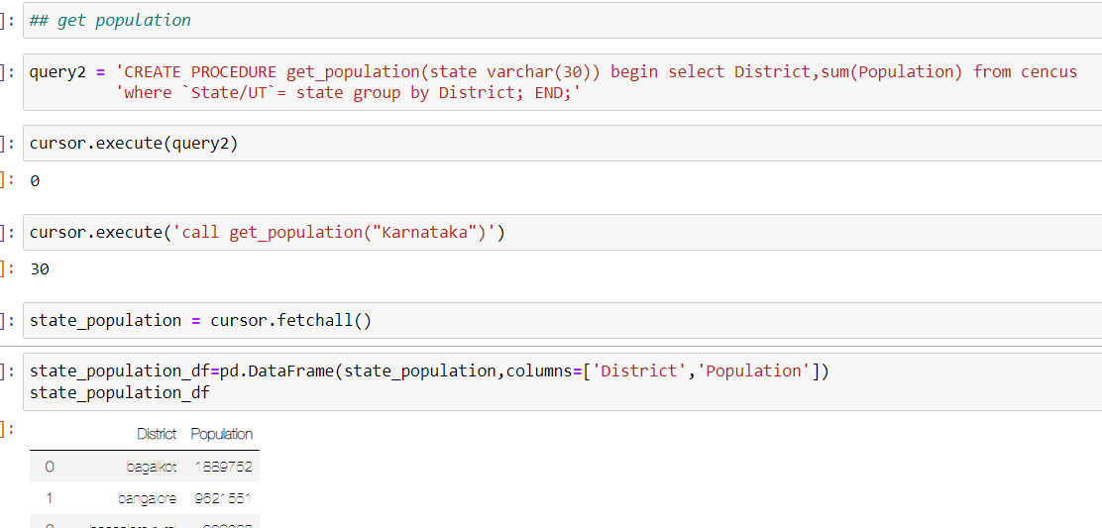
Code Snippets
Creation and execution of stored procedure to get population of a state

Slide 20
Optimizations and Best Practices Used:
A function was created so that it can be used to create uniformity and remove discrepancies among state names in all datasets
Check points of the dataframes were created in case loss of progress due to unforeseen circumstances

Slide 21
Roadblocks
Resolutions
Not able to merge dataframes and get proper results due to discrepancy in state names in cencus and housing data
Changed the state names of districts which had a newly formed state and created a function to maintain uniformity among state names across all data frames

Slide 22
Future Scope:
Using tools like PowerBI , Tableau to create better visualizations
Creating a web page for the analysis.

Slide 23
Thank You

